Slide 1

Solve the riddle.
I’m a country in Great Britain
Where you might drink a nice cup of tea.
My capital is called London.
I’m a home to the Royal Family.
The answer is: ENGLAND.
Take a virtual stroll down the most famous places in London.

Slide 2


England
CULTURE SPOT

Slide 3
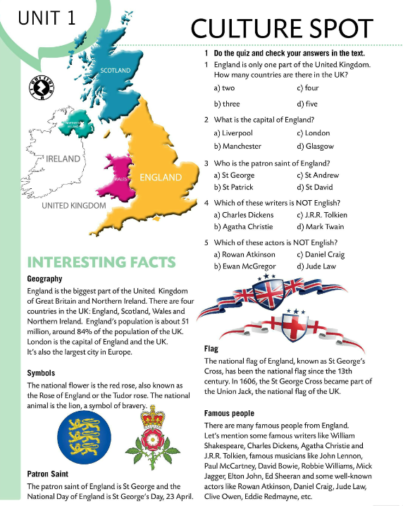
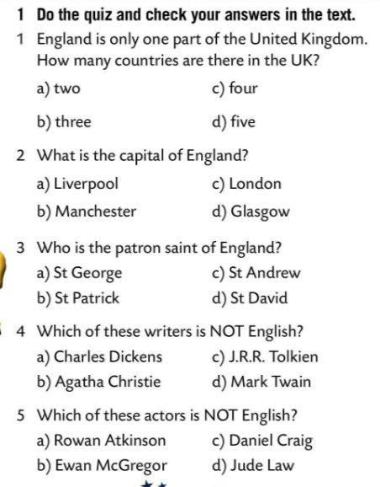
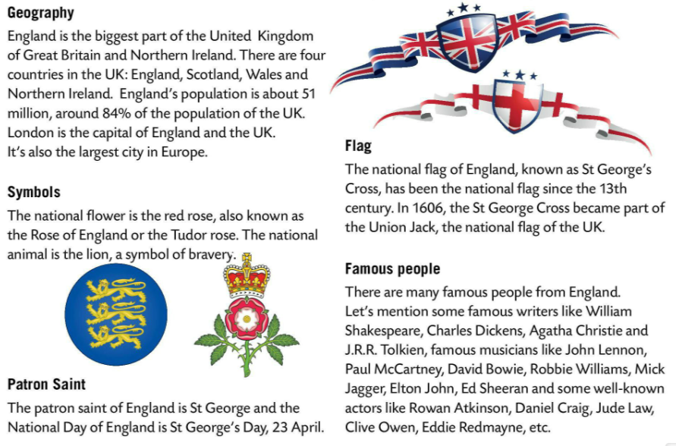

Do the quiz and check your answers in the text.
Read the text.
Let’s check!
Write five sentences about England.

Slide 4
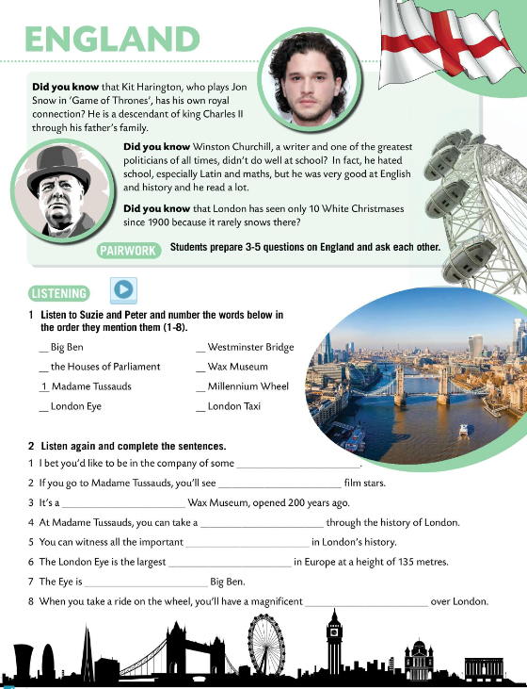
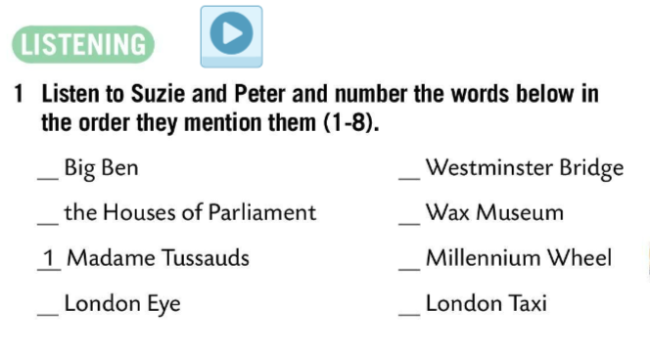
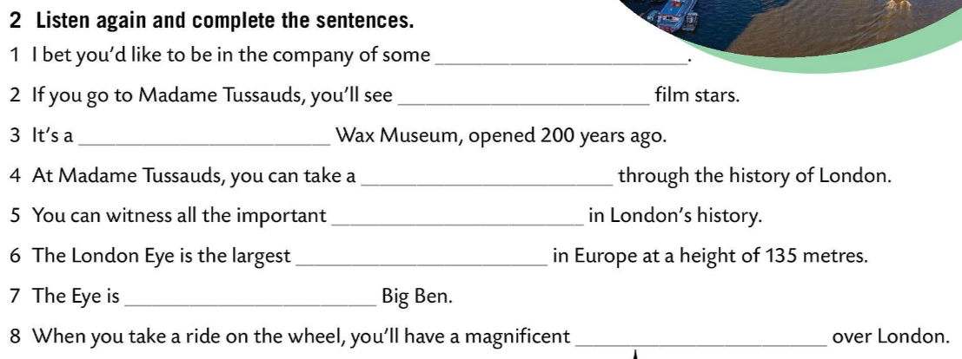

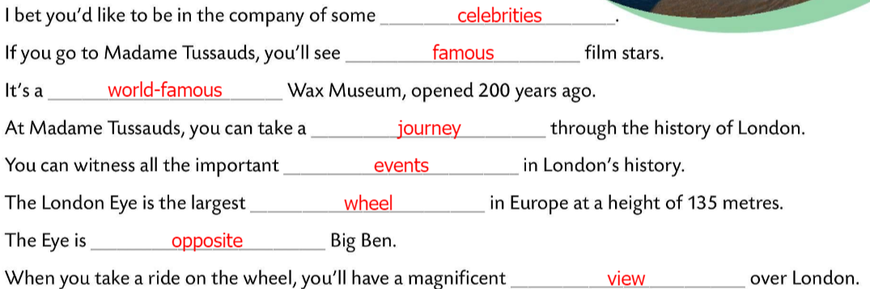
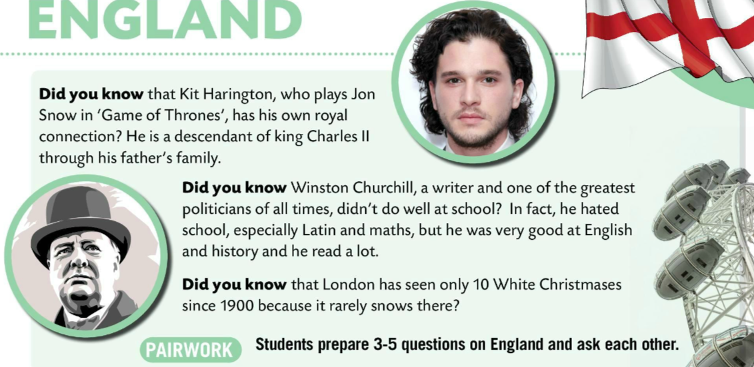
Read the text in pairs and ask 3 – 5 questions on England.
Listen to Suzie and Peter and number the words below in the order they mention them (1-8).
Check.
Listen again and complete the sentences.
Check.

Slide 5
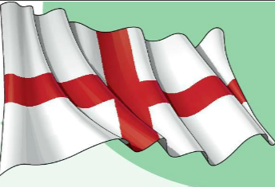

Play this quiz and see how much you know about England.
https://wordwall.net/play/846/445/943
Make a poster. Include the most important information. You can add some drawings and make the poster colourful. Enjoy! ☺

